Slide 1
Jermyn Borough Council Meeting
10/21/21

Slide 2
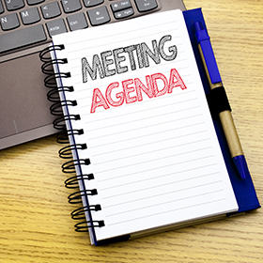
Meeting Agenda
OCTOBER 21,2021
CALL TO ORDER
PLEDGE OF ALLEGIANCE
ROLL CALL
PREVIOS MEETING MINUTES(9/16/21)
TREASURER REPORT/BILLS PAYABLE
CORRESPONDENCE
PUBLIC COMMENT
PROFESSIONAL REPORTS
COMMITTEE REPORTS
BRIDGE STREET NO PARKING ORD
ANDREW FORD ( AT REQUEST OF CINDY)
CIVIL SERVICE COMM
BACON STREET PROJECT
DWIGHT PAVING
BOROUGH MANAGER POSITION
SEC/TREASURER POSITION APPOINTMENT

Slide 3
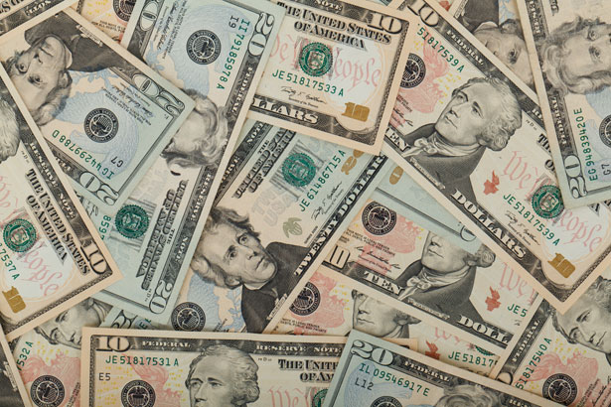
Treasurer’s report
10/21/21
ASSETS
Checking/Savings
American Rescue Plan Fund 95,750.37
Capital Reserve - DPW 10,524.40
Capital Reserve - Police 4,486.82
Crime Watch Fund 222.69
General Fund - Community 147,578.32
General Fund - FNB 4,294.58
Holiday Lights Fund 940.14

Slide 4
Treasurer’s report
Investment - General Fund 1,001.57
Investment - Liquid Fuels 33,815.49
Investment - Paving Fund 1,011.93
Investment - Recycling 5,003.63
Investment - Refuse 2,600.31
Liquid Fuels - FNB 32,581.84
Petty Cash 231.00
Recreations Fund 15,474.25
Recycling - Community 8,673.76
Refuse Checking - FNB 85,001.21
Total Checking/Savings 449,192.31

Slide 5
Treasurer’s report
200000 · Accounts Payable 76,902.01

